Slide 1
Why I Was Wrong About TypeScript
TJ VanToll

Slide 2
TypeScript

Slide 3
TypeScript
Triple-Slash Directives
Declaration files
Namespaces
Structural detection
Classes
Compiler options
Type Inference
Modules
Generators
Declaration merging
Decorators
Generics
Mixins
Sequential piping
Symbols

Slide 4
TypeScript
Triple-Slash Directives
Declaration files
Namespaces
Structural detection
Classes
Compiler options
Type Inference
Modules
Generators
Declaration merging
Decorators
Generics
Mixins
Sequential piping
Symbols

Slide 5
Why I Was Wrong About TypeScript

Slide 6
Whether TypeScript is a good fit for your next project

Slide 7
Why I Was Wrong About TypeScript

Slide 8
“A typed superset of JavaScript that compiles to plain JavaScript”

Slide 9
“A typed superset of JavaScript that compiles to plain JavaScript”

Slide 10


Slide 11
😍

Slide 12
😠

Slide 13
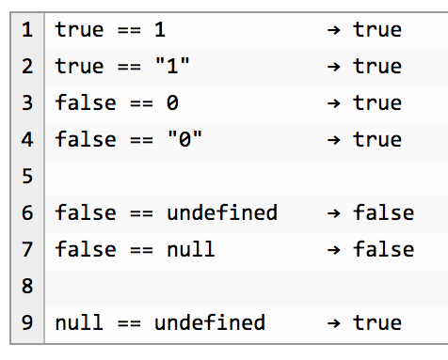

Slide 14
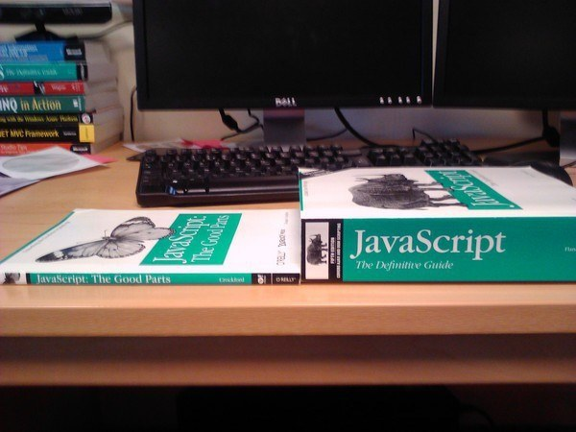
Notes:
34

Slide 15
Compile to JavaScript tools
There are a lot.
345
Source: https://github.com/jashkenas/coffeescript/wiki/List-of-languages-that-compile-to-JS
Ruby, Python, Erlang, Java, Scala, C#, F#, Lisp, Scheme, Haskell, Smalltalk, C, C++, Basic, Go, PHP, and way more.

Slide 16
Fun names of compile-to-JS tools
treehugger
jangaroo
Waterbear

Slide 17
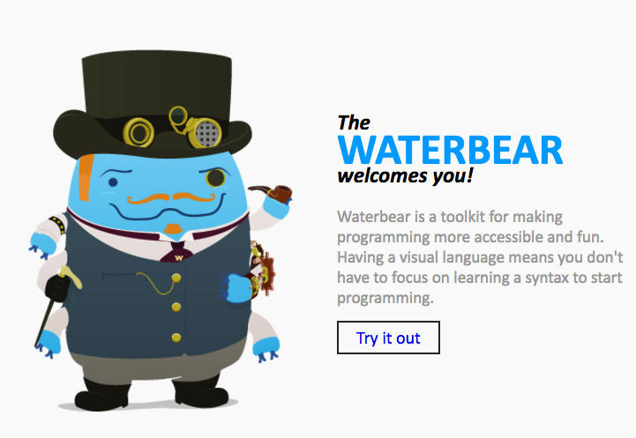
http://waterbearlang.com/

Slide 18
Compile to JavaScript tools
There are a lot.
345
Source: https://github.com/jashkenas/coffeescript/wiki/List-of-languages-that-compile-to-JS
Ruby, Python, Erlang, Java, Scala, C#, F#, Lisp, Scheme, Haskell, Smalltalk, C, C++, Basic, Go, PHP, and way more.

Slide 19
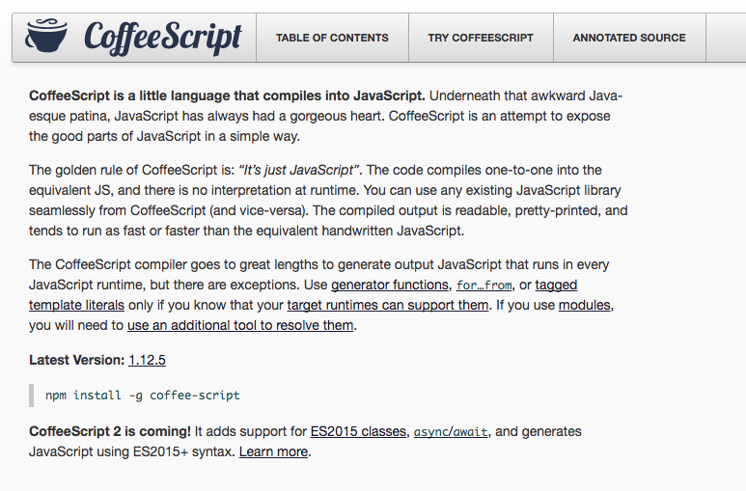
Notes:
2009

Slide 20
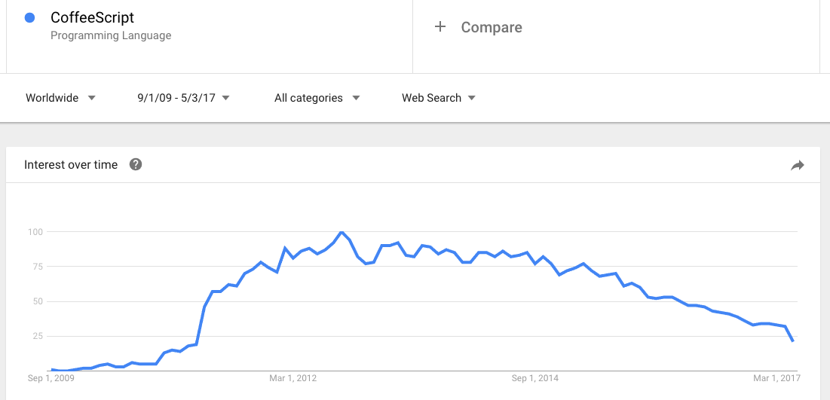

Slide 21
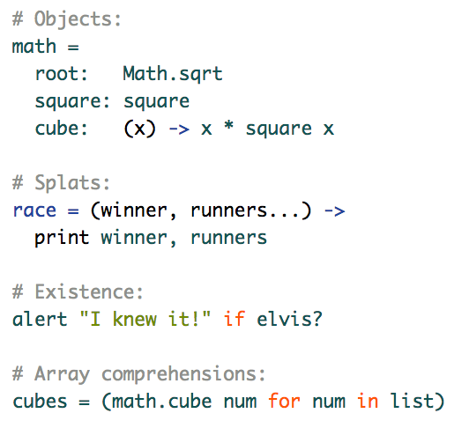

Slide 22
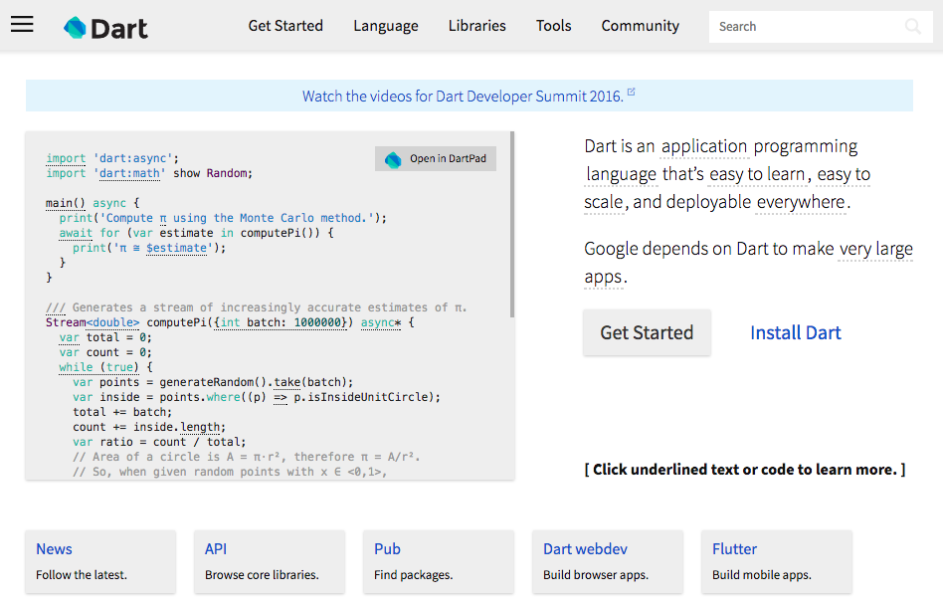
Notes:
2011

Slide 23
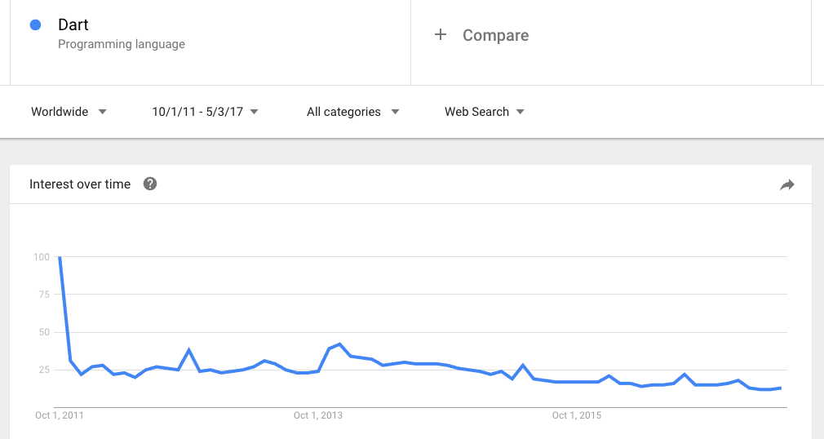

Slide 24
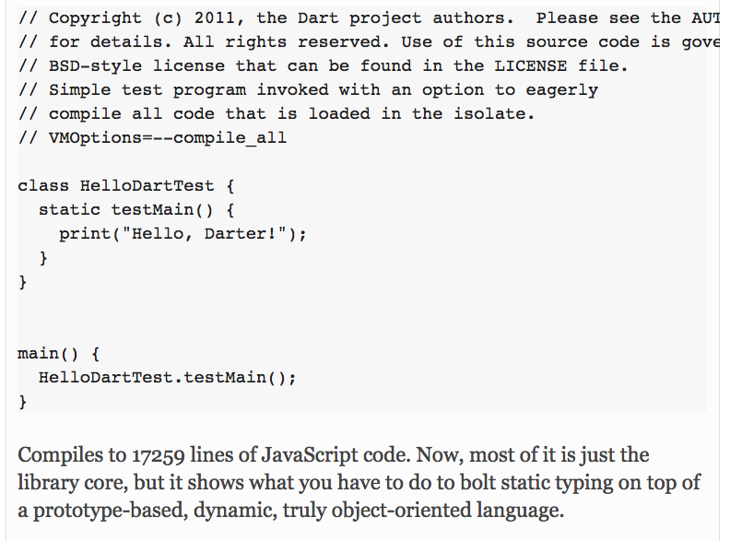

Slide 26


Slide 27
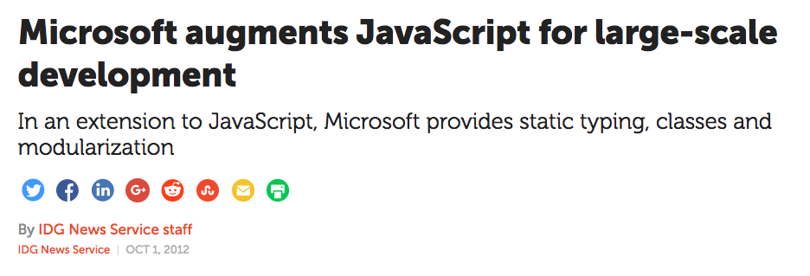
Notes:
October 2012

Slide 28
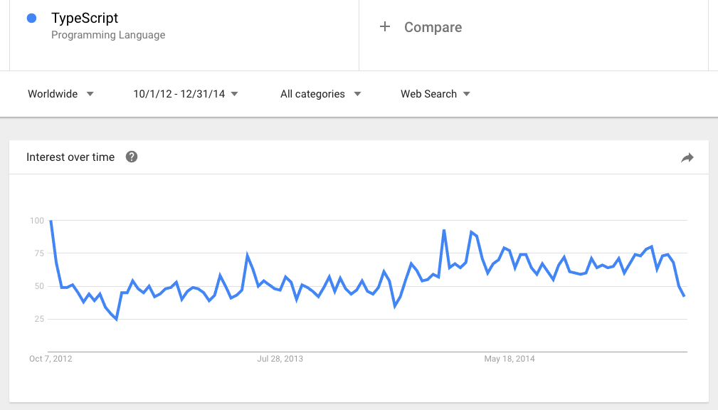

Slide 29
Why I Was Wrong About TypeScript

Slide 30


Slide 31


Slide 33


Slide 34


Slide 35
✉️

Slide 36
“We risk a lot by building our core on top of TypeScript.”

Slide 37
“I don’t hear anyone talking about TypeScript.”

Slide 38
“I like to keep my JavaScript pure, as God intended.”

Slide 39
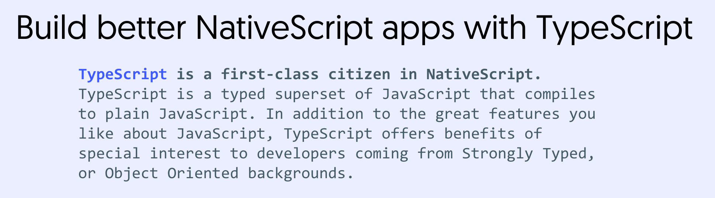

Slide 40
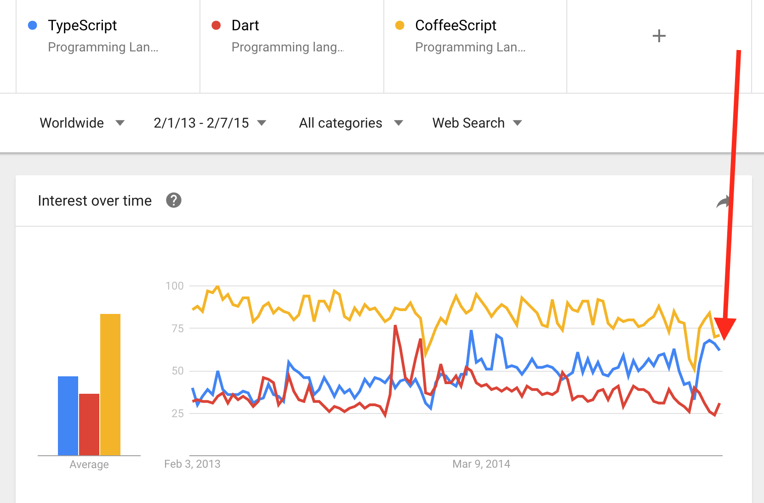

Slide 41
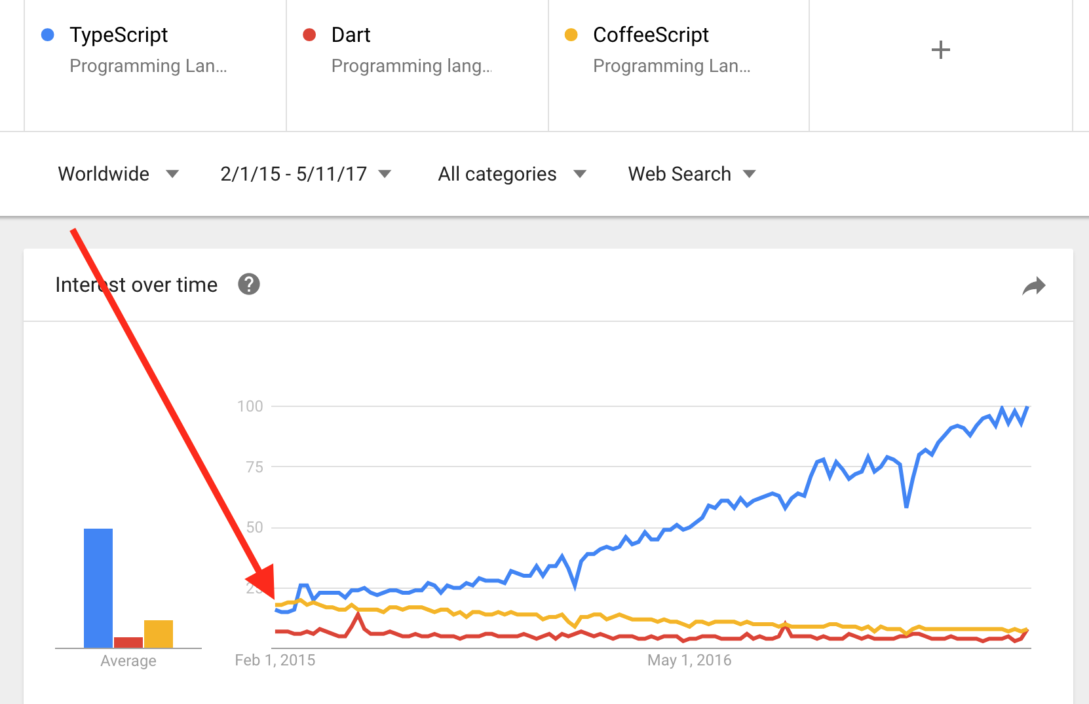

Slide 42
Why I Was Wrong About TypeScript

Slide 43
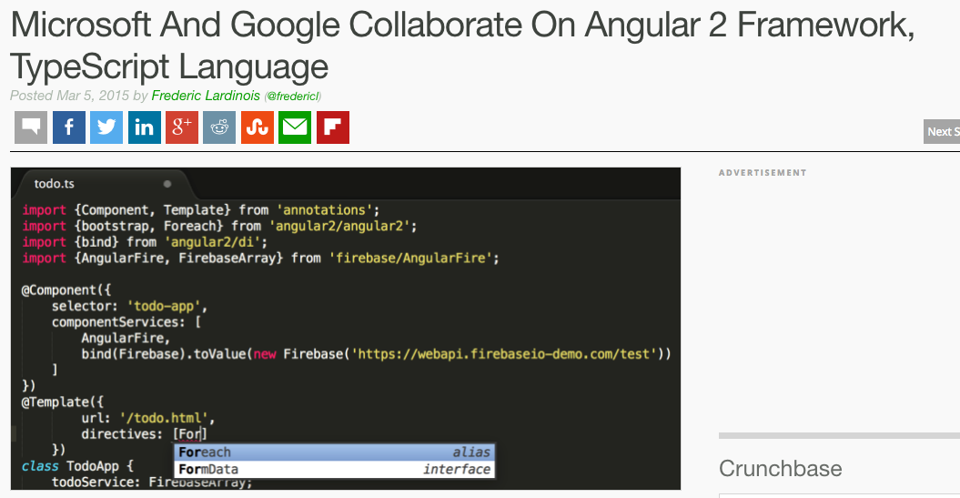

Slide 44
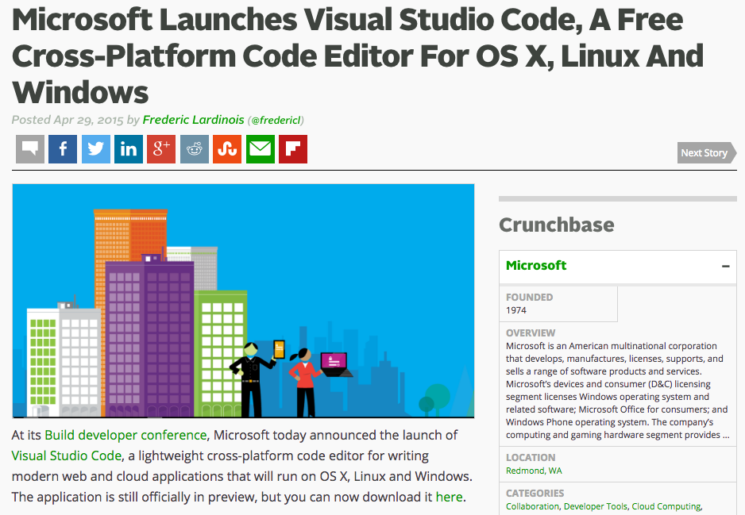

Slide 45
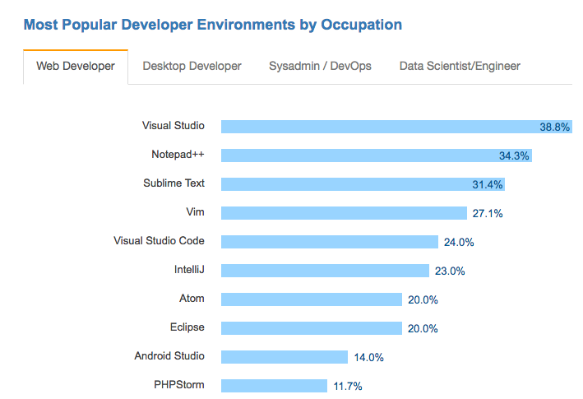

Slide 46
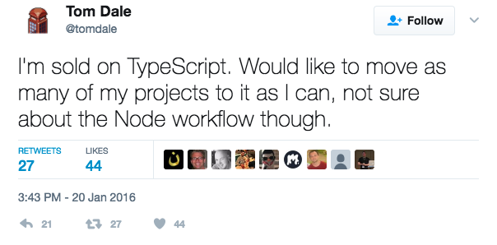

Slide 47
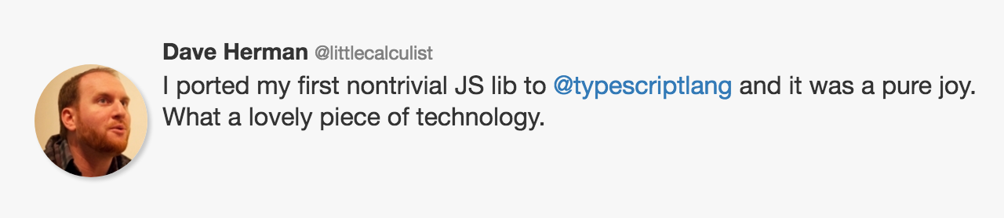

Slide 48
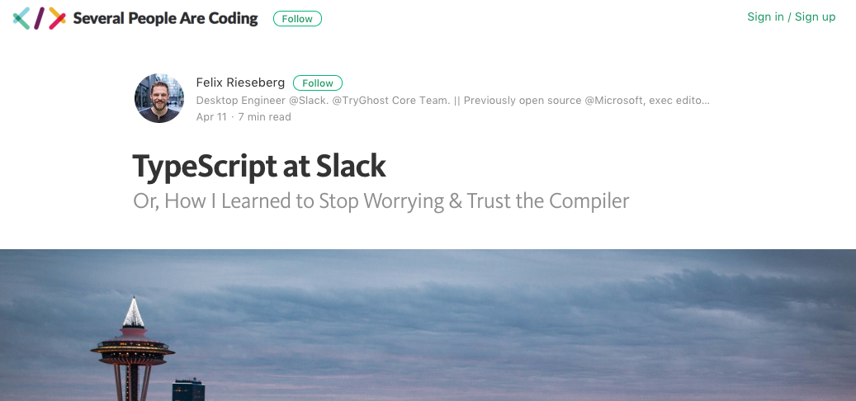

Slide 49
Why?

Slide 50
3 reasons

Slide 51
1) Commitment to the ECMAScript standard

Slide 52
“Some examples [of compile-to-JavaScript frameworks], like Dart, portend that JavaScript has fundamental flaws and to support these scenarios requires a “clean break” from JavaScript in both syntax and runtime. We disagree with this point of view. We believe that with committee participant focus, the standards runtime can be expanded and the syntactic features necessary to support JavaScript at scale can be built upon the existing JavaScript standard.”

Slide 53
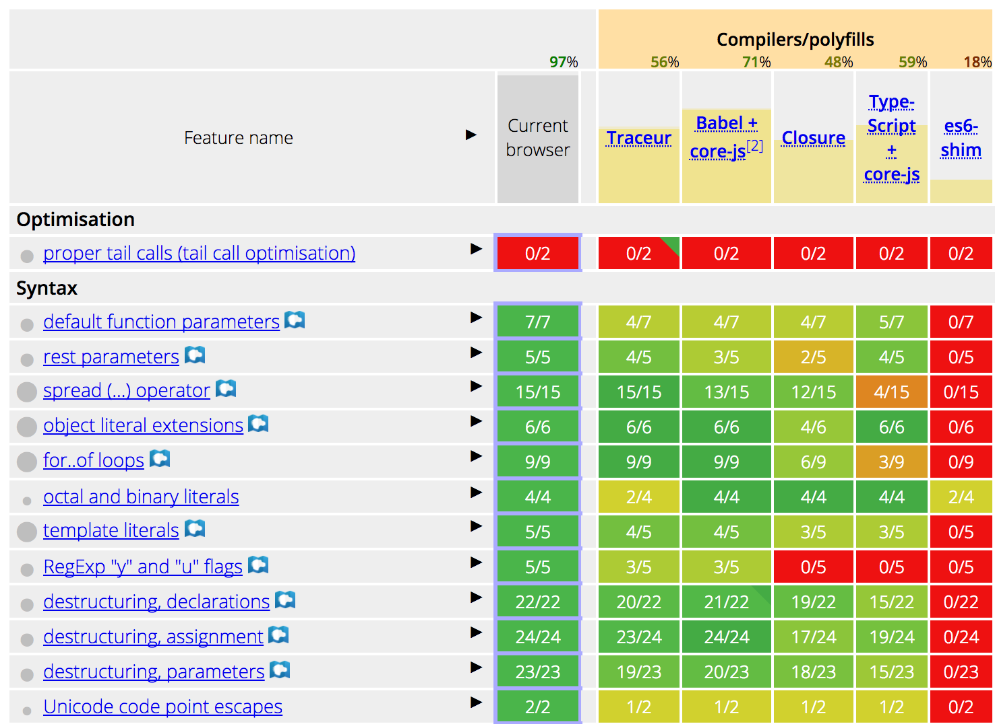

Slide 54
2) Types are opt-in

Slide 55
3) Tooling

Slide 56
So should you use TypeScript?
Are your apps big?
Do you work on a team?
Unfamiliar codebases?
Non JS developers that need to write JS code?

Slide 57
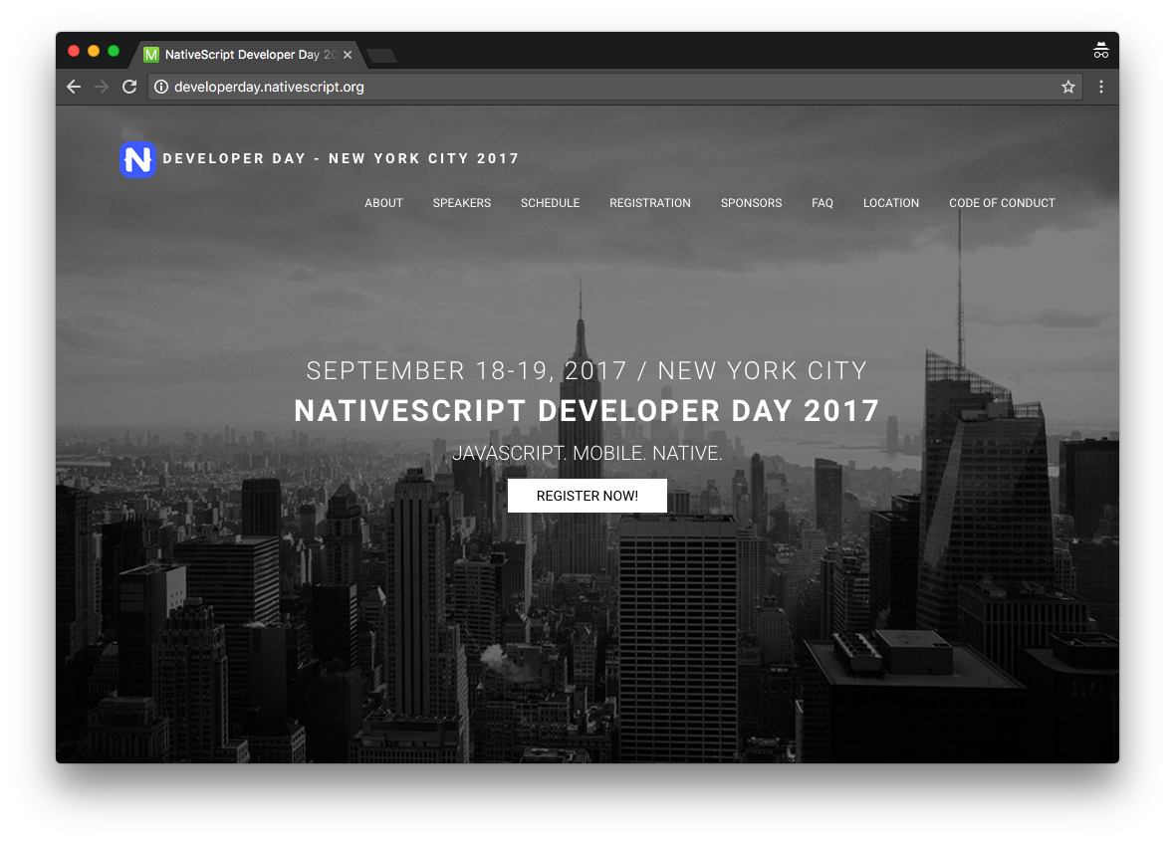
http://developerday.nativescript.org/?discount=TJVANTOLL

Slide 58
Thanks!
@tjvantoll
Notes:
Feel free to swap out the Progress logo with your own logo.

